Slide 1
EKT214 - ANALOGUE ELECTRONIC CIRCUIT II
Chapter 5
Active Filter

Slide 2
Introduction
Filters are circuits that are capable of passing signals within a band of frequencies while rejecting or blocking signals of frequencies outside this band. This property of filters is also called “frequency selectivity”.
Filter can be passive or active filter.
Passive filters: The circuits built using RC, RL, or RLC circuits.
Active filters : The circuits that employ one or more
op-amps in the design an addition to
resistors and capacitors

Slide 3
Advantages of Active Filters over Passive Filters
Active filters can be designed to provide required gain, and hence no attenuation as in the case of passive filters
No loading problem, because of high input resistance and low output resistance of op-amp.
Active Filters are cost effective as a wide variety of economical op-amps are available.

Slide 4
Applications
Active filters are mainly used in communication and signal processing circuits.
They are also employed in a wide range of applications such as entertainment, medical electronics, etc.

Slide 5
Active Filters
There are 4 basic categories of active filters:
1. Low-pass filters
High-pass filters
Band-pass filters
Band-reject filters
Each of these filters can be built by using op-amp as the active element combined with RC, RL or RLC circuit as the passive elements.

Slide 6
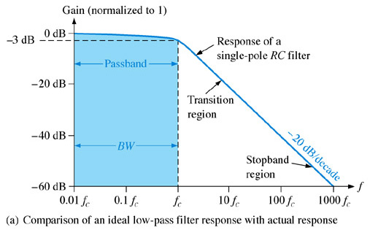
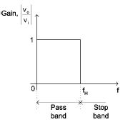
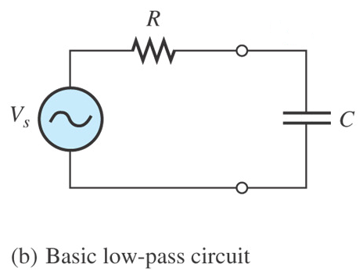
BASIC FILTER RESPONSES
Low-Pass Filter Response
A low-pass filter is a filter that passes frequencies from 0Hz to critical frequency, f_{c} and significantly attenuates all other frequencies.
roll-off rate
V_{o}
Actual response
Ideal response
Ideally, the response drops abruptly at the critical frequency, f_{H}

Slide 7
Passband of a filter is the range of frequencies that are allowed to pass through the filter with minimum attenuation (usually defined as less than -3 dB of attenuation).
Transition region shows the area where the fall-off occurs.
roll-off rate
Stopband is the range of frequencies that have the most attenuation.
Critical frequency, f_{c}, (also called the cutoff frequency) defines the end of the passband and normally specified at the point where the response drops – 3 dB (70.7%) from the passband response.

Slide 8
V_{o}
At low frequencies, X_{C} is very high and the capacitor circuit can be considered as open circuit. Under this condition, V_{o} = V_{in} or A_{V} = 1 (unity).
At very high frequencies, X_{C} is very low and the V_{o} is small as compared with V_{in}. Hence the gain falls and drops off gradually as the frequency is increased.

Slide 9
The bandwidth of an ideal low-pass filter is equal to f_{c}:
The critical frequency of a low-pass RC filter occurs when
X_{C} = R and can be calculated using the formula below:

Slide 10
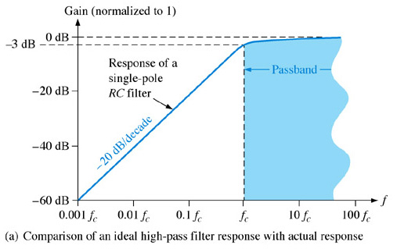
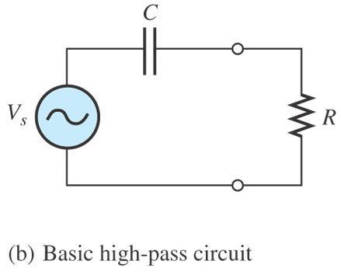
High-Pass Filter Response
A high-pass filter is a filter that significantly attenuates or rejects all frequencies below f_{c} and passes all frequencies above f_{c}.
The passband of a high-pass filter is all frequencies above the critical frequency.
V_{o}
Actual response
Ideal response
Ideally, the response rises abruptly at the critical frequency, f_{L}

Slide 11
The critical frequency of a high-pass RC filter occurs when
X_{C} = R and can be calculated using the formula below:

Slide 12
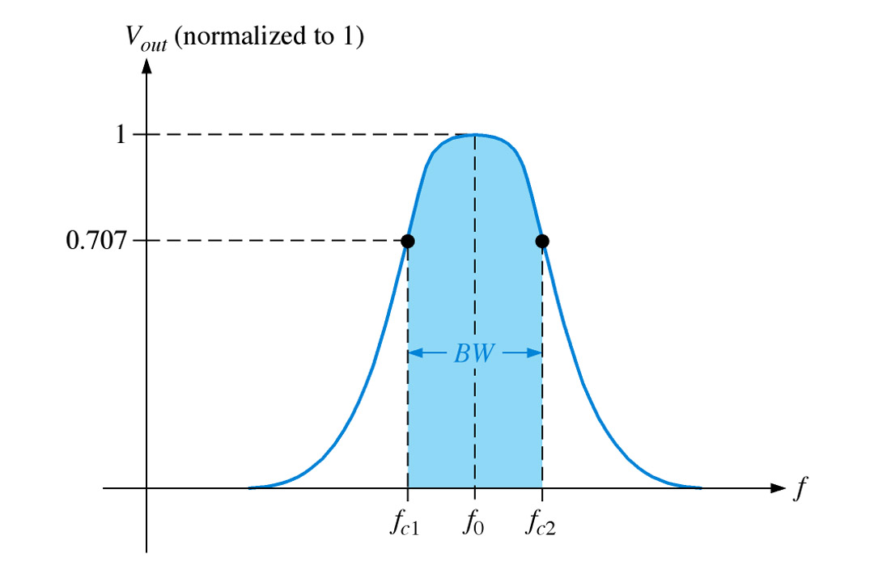
Band-Pass Filter Response
A band-pass filter passes all signals lying within a band between a lower-frequency limit and upper-frequency limit and essentially rejects all other frequencies that are outside this specified band.
Actual response
Ideal response

Slide 13
The bandwidth (BW) is defined as the difference between the upper critical frequency (f_{c2}) and the lower critical frequency (f_{c1}).

Slide 14
The frequency about which the pass band is centered is called the center frequency, f_{o} and defined as the geometric mean of the critical frequencies.

Slide 15
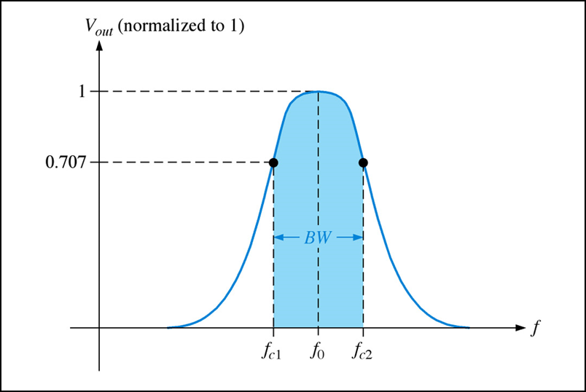
The quality factor (Q) of a band-pass filter is the ratio of the center frequency to the bandwidth.
The higher value of Q, the narrower the bandwidth and the better the selectivity for a given value of f_{o.}
(Q>10) as a narrow-band or (Q<10) as a wide-band
The quality factor (Q) can also be expressed in terms of the damping factor (DF) of the filter as :

Slide 16
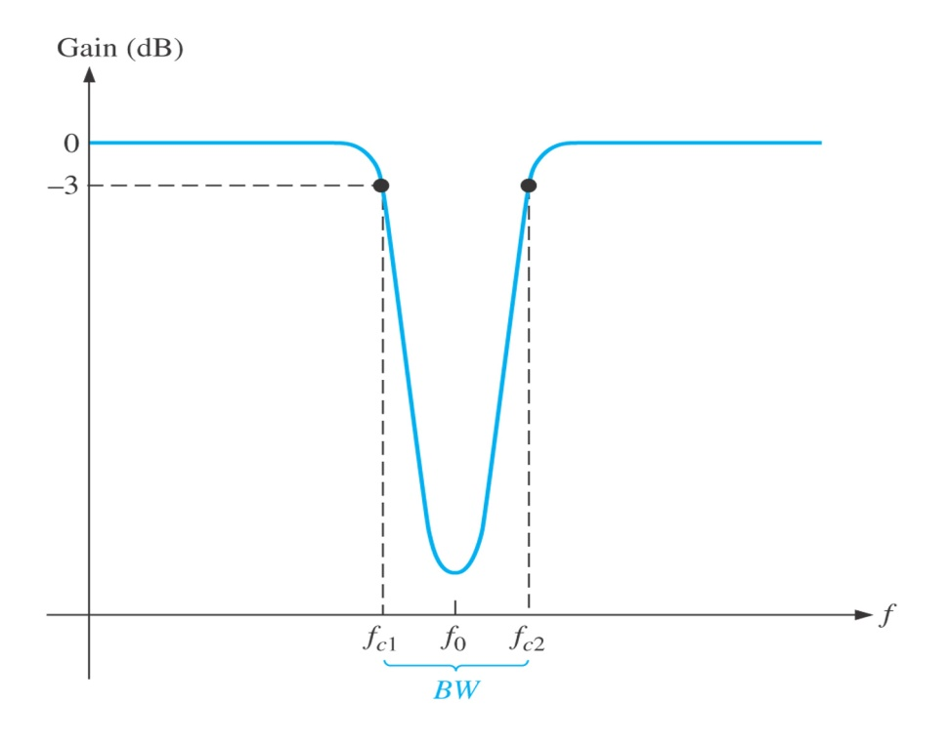
Band-Stop Filter Response
Band-stop filter is a filter which its operation is opposite to that of the band-pass filter because the frequencies within the bandwidth are rejected, and the frequencies above f_{c1} and f_{c2} are passed.
For the band-stop filter, the bandwidth is a band of frequencies between the 3 dB points, just as in the case of the band-pass filter response.
Actual response
Ideal response

Slide 17
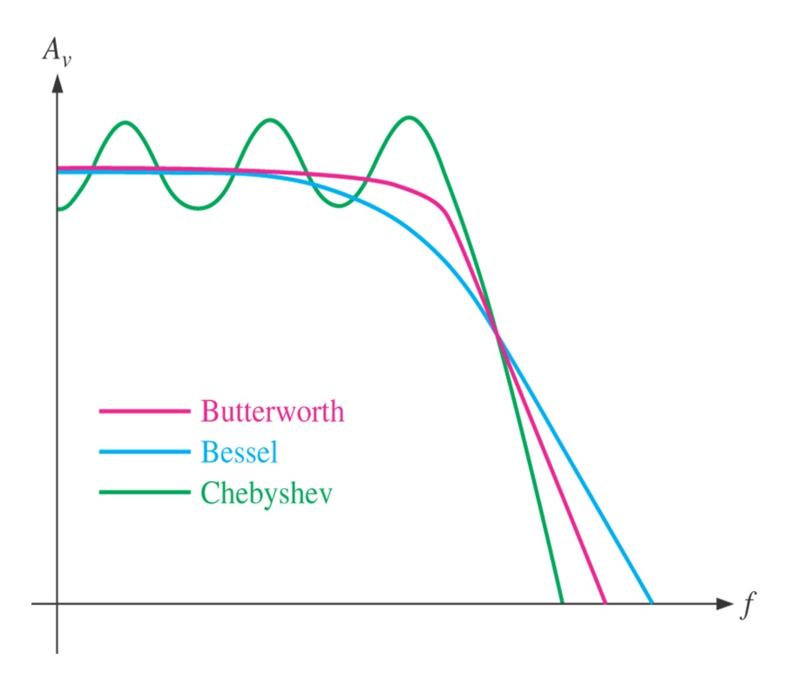
FILTER RESPONSE CHARACTERISTICS
There are 3 characteristics of filter response :
i) Butterworth characteristic
ii) Chebyshev characteristic
iii) Bessel characteristic.
Comparative plots of three types of filter response characteristics.
Each of the characteristics is identified by the shape of the response
curve

Slide 18

Butterwoth Characteristic
Filter response is characterized by
flat amplitude response in the
passband.
Provides a roll-off rate of -20
dB/decade/pole.
Filters with the Butterworth
response are normally used when
all frequencies in the passband
must have the same gain.

Slide 19

Chebyshev Characteristic
Filter response is characterized
by overshoot or ripples in the
passband.
Provides a roll-off rate greater
than -20 dB/decade/pole.
Filters with the Chebyshev
response can be implemented
with fewer poles and less
complex circuitry for a given
roll-off rate

Slide 20

Bessel Characteristic
Filter response is characterized by a
linear characteristic, meaning that the
phase shift increases linearly with
frequency.
Filters with the Bessel response are
used for filtering pulse waveforms
without distorting the shape of
waveform.

Slide 21
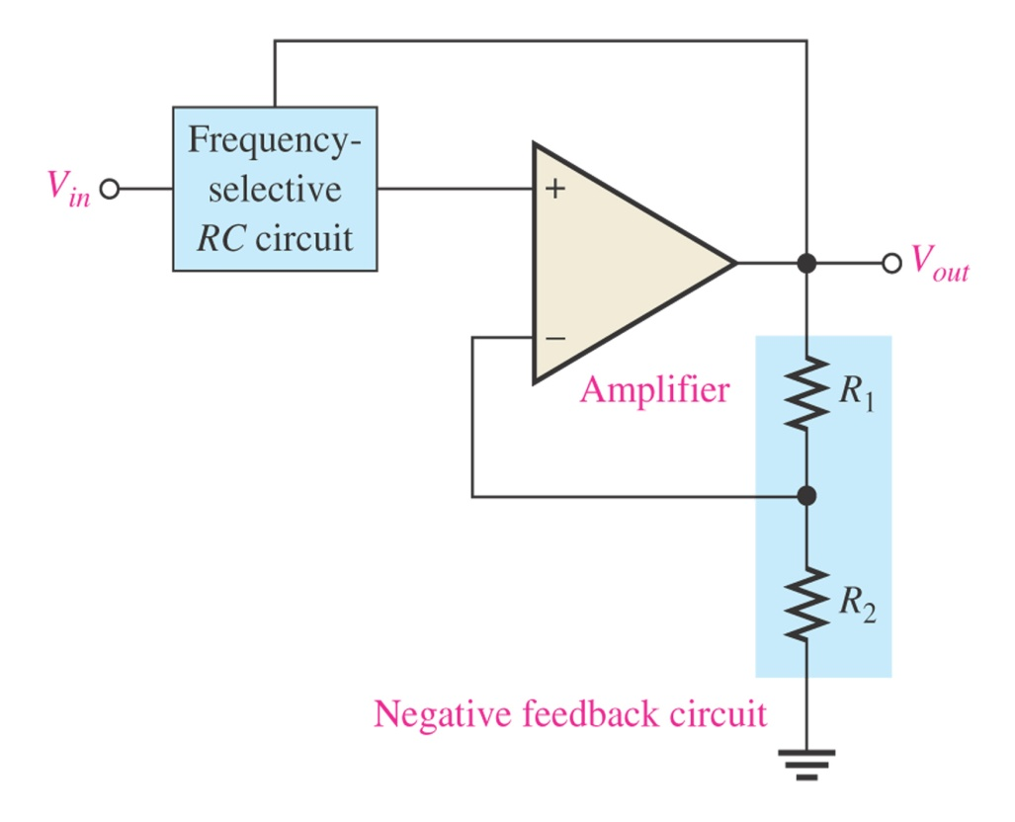
DAMPING FACTOR
The damping factor (DF) of an active filter determines which response characteristic the filter exhibits.
This active filter consists of an amplifier, a negative feedback circuit and RC circuit.
The amplifier and feedback are connected in a non-inverting configuration.
DF is determined by the negative feedback and defined as :
General diagram of active filter

Slide 22
The value of DF required to produce a desired response characteristics depends on order (number of poles) of the filter.
A pole (single pole) is simply one resistor and one capacitor.
The more poles filter has, the faster its roll-off rate

Slide 23
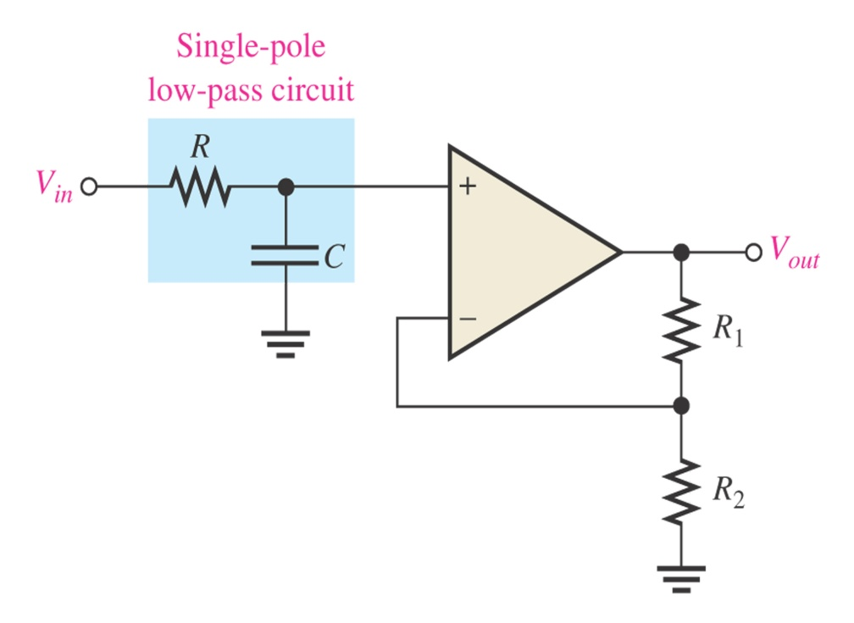
CRITICAL FREQUENCY AND ROLL-OFF RATE
One-pole (first-order) low-pass filter.
The critical frequency, f_{c} is determined by the values of R and C in the frequency-selective RC circuit.
Each RC set of filter components represents a pole.
Greater roll-off rates can be achieved with more poles.
Each pole represents a -20dB/decade increase in roll-off.

Slide 24
For a single-pole (first-order) filter, the critical frequency is :
The above formula can be used for both low-pass and high-pass filters.

Slide 25
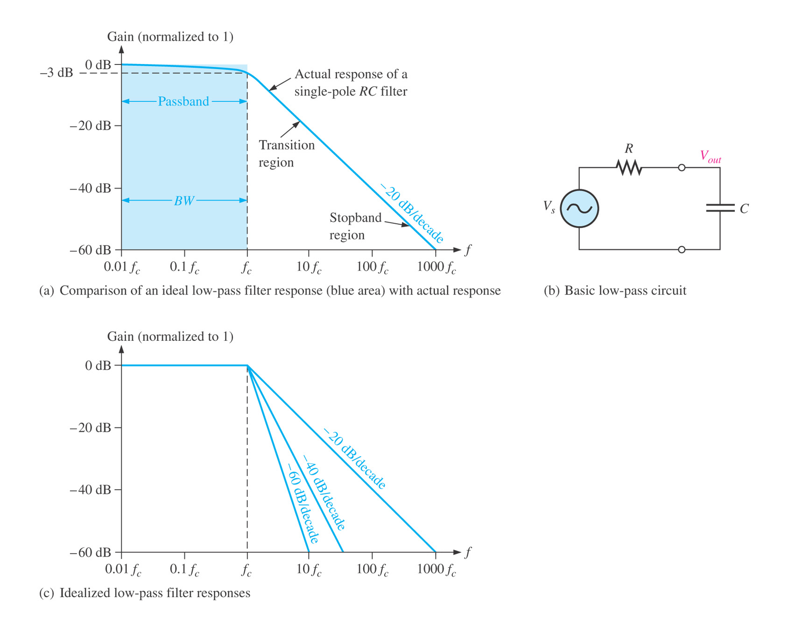
The number of poles determines the roll-off rate of the filter. For example, a Butterworth response produces -20dB/decade/pole.
This means that:
One-pole (first-order) filter has a roll-off of -20 dB/decade
Two-pole (second-order) filter has a roll-off of -40 dB/decade
Three-pole (third-order) filter has a roll-off of -60 dB/decade

Slide 26
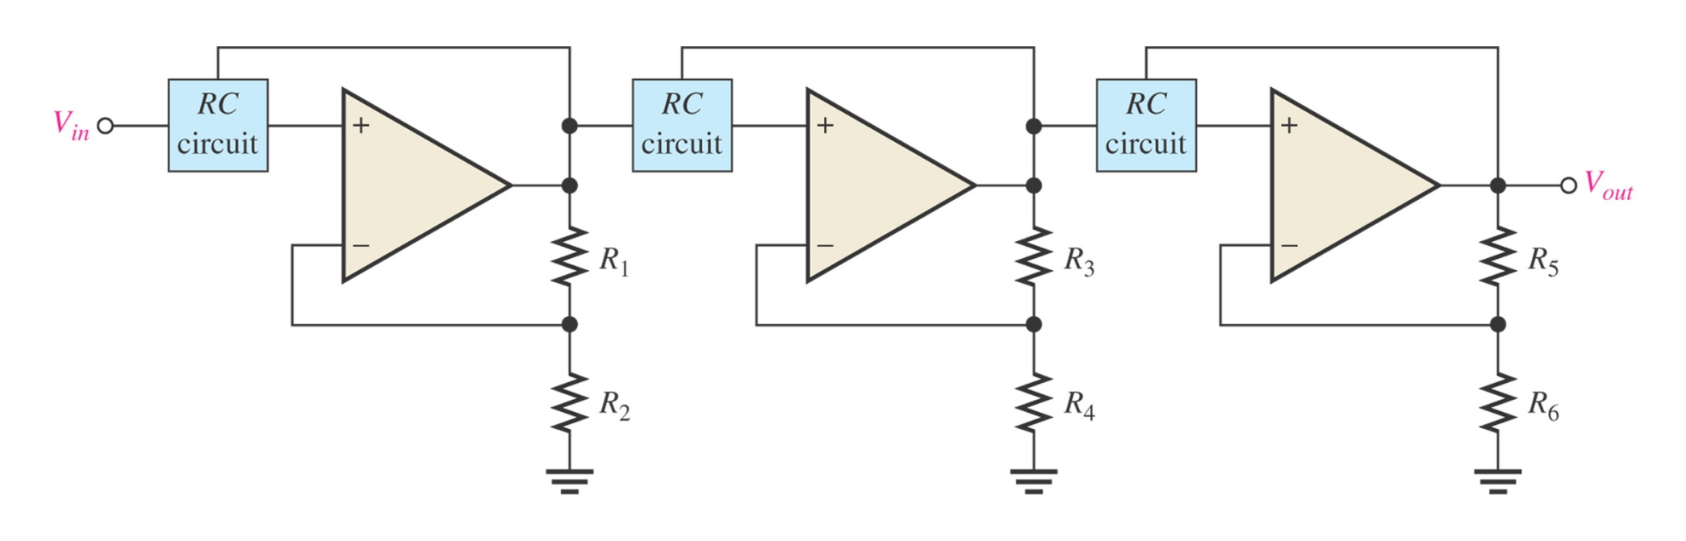
The number of filter poles can be increased by cascading. To obtain a filter with three poles, cascade a two-pole with one-pole filters.
Three-pole (third-order) low-pass filter.

Slide 27
ACTIVE LOW-PASS FILTERS
Advantages of active filters over passive filters (R, L, and C
elements only):
By containing the op-amp, active filters can be designed to provide required gain, and hence no signal attenuation as the signal passes through the filter.
2. No loading problem, due to the high input impedance of the op-amp prevents excessive loading of the driving source, and the low output impedance of the op-amp prevents the filter from being affected by the load that it is driving.
3. Easy to adjust over a wide frequency range without altering the desired response.

Slide 28
Figure below shows the basic Low-Pass filter circuit
At critical frequency,
Resistance = reactance
So, critical frequency ;

Slide 29
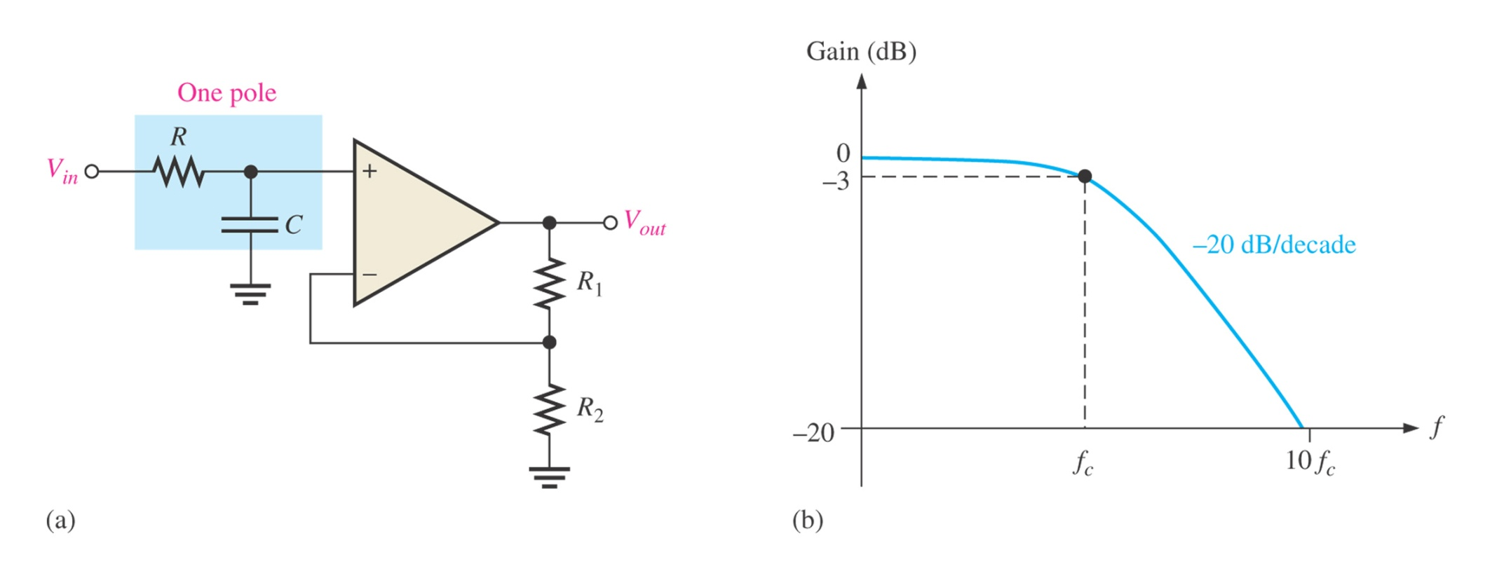
Single-Pole Filter
Single-pole active low-pass filter and response curve.
This filter provides a roll-off rate of -20 dB/decade above the critical frequency.

Slide 30
The op-amp in single-pole filter is connected as a noninverting amplifier with the closed-loop voltage gain in the passband is set by the values of R₁ and R₂ :
The critical frequency of the single-pole filter is :

Slide 31
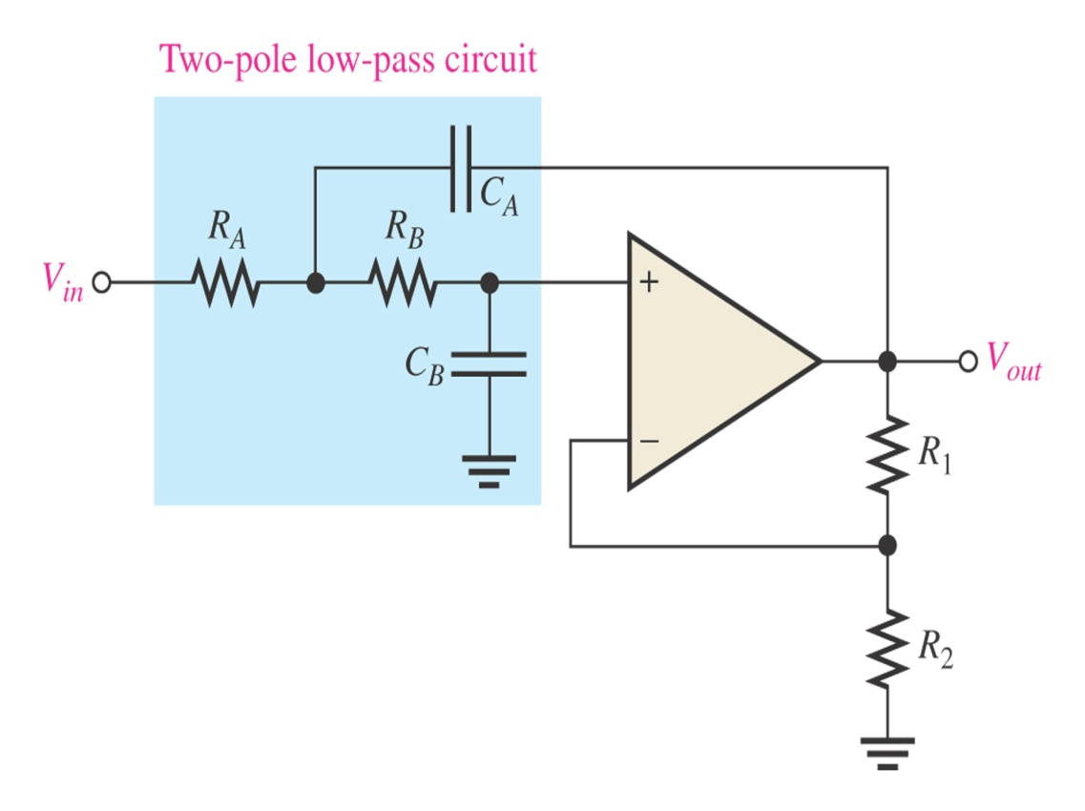
Sallen-Key Low-Pass Filter
Sallen-Key is one of the most common configurations for a second order (two-pole) filter.
There are two low-pass RC circuits that provide a roll-off of -40 dB/decade above f_{c} (assuming a Butterworth characteristics).
One RC circuit consists of R_{A} and C_{A}, and the second circuit consists of R_{B} and C_{B}.
Basic Sallen-Key low-pass filter.

Slide 32
The critical frequency for the Sallen-Key filter is :
For R_{A} = R_{B} = R and C_{A} = C_{B} = C, thus the critical frequency :

Slide 33
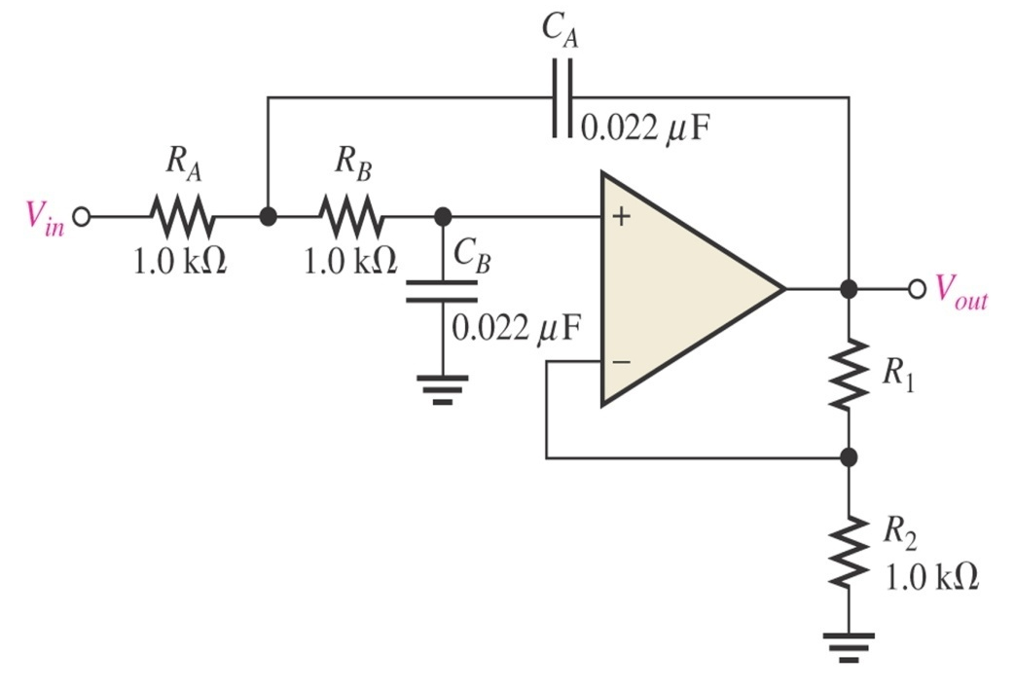
Example :
Determine critical frequency
Set the value of R₁ for Butterworth response by giving
that Butterworth response for second order is 0.586
Critical frequency
Butterworth response given
R₁/R₂ = 0.586

Slide 34
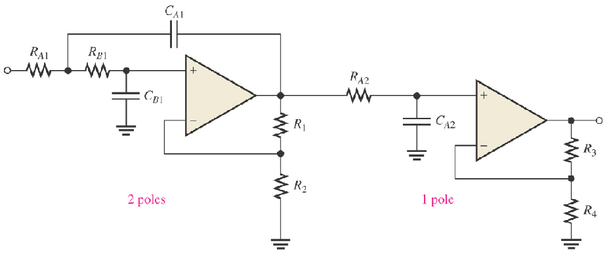
Cascading Low-Pass Filter
A three-pole filter is required to provide a roll-off rate of -60 dB/decade. This is done by cascading a two-pole Sallen-Key low-pass filter and a single-pole low-pass filter.
Cascaded low-pass filter: third-order configuration.

Slide 35
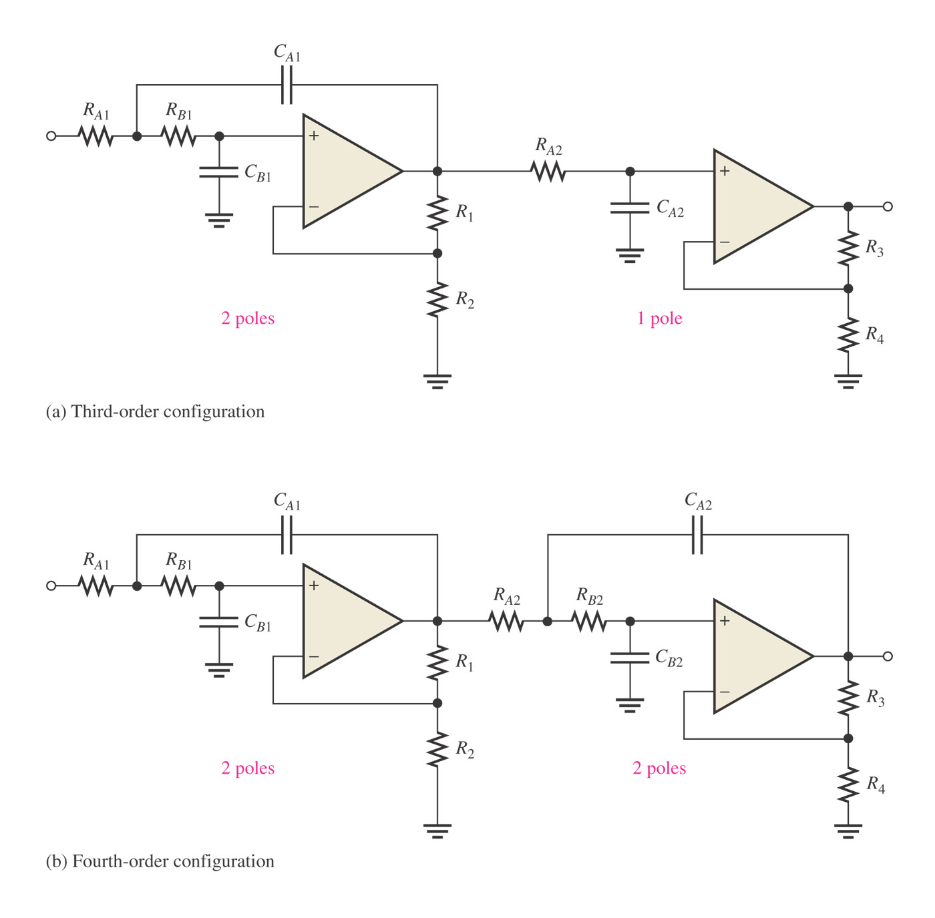
A four-pole filter is required to provide a roll-off rate of -80 dB/decade. This is done by cascading a two-pole Sallen-Key low-pass filter and a two-pole Sallen-Key low-pass filter.
Cascaded low-pass filter: fourth-order configuration.

Slide 36
Example :
Determine the capacitance values required to produce a critical
frequency of 2680 Hz if all resistors in RC low pass circuit is
1.8kΩ
C_{A1}=C_{B1}=C_{A2}=C_{B2}=0.033µf
Both stages must have the same f_{c}. Assume equal-value of capacitor

Slide 37
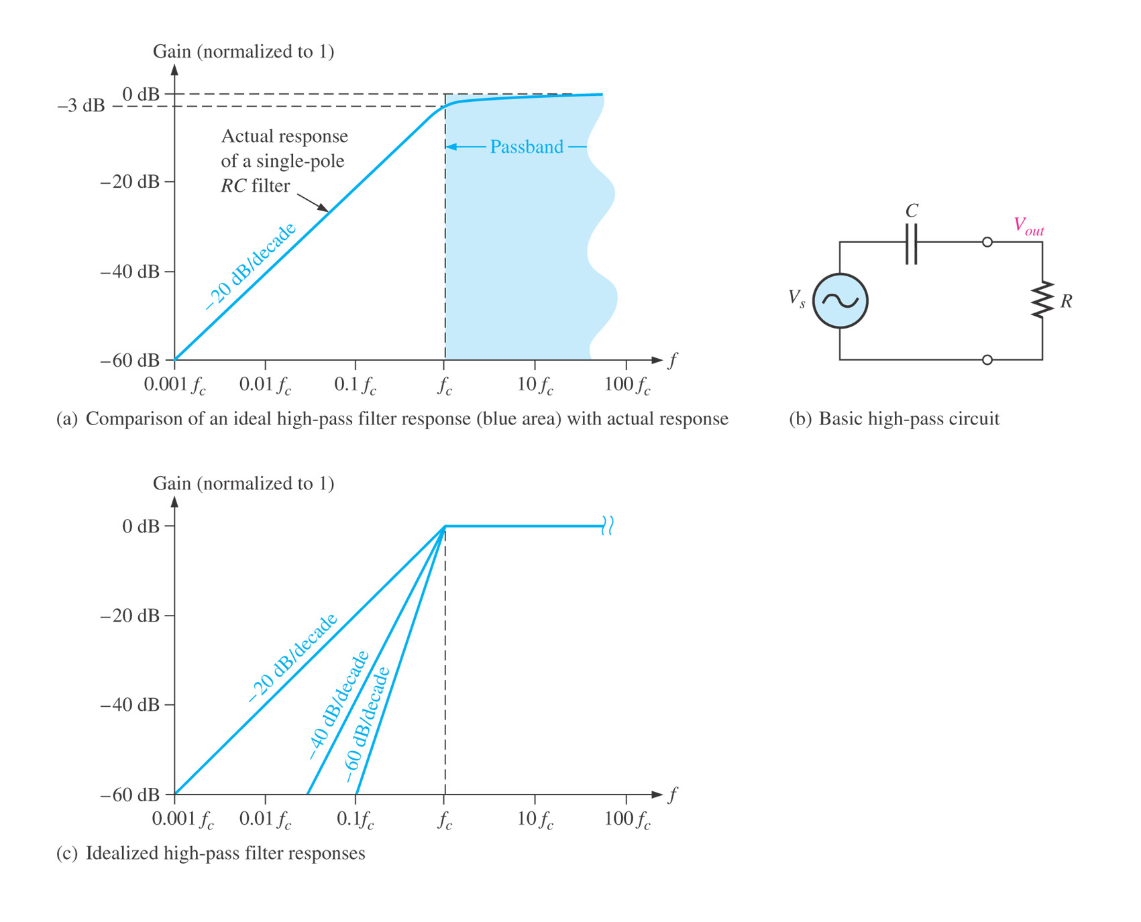
ACTIVE HIGH-PASS FILTERS
Figure below shows the basic High-Pass filter circuit :
At critical frequency,
Resistance = reactance
So, critical frequency ;

Slide 38
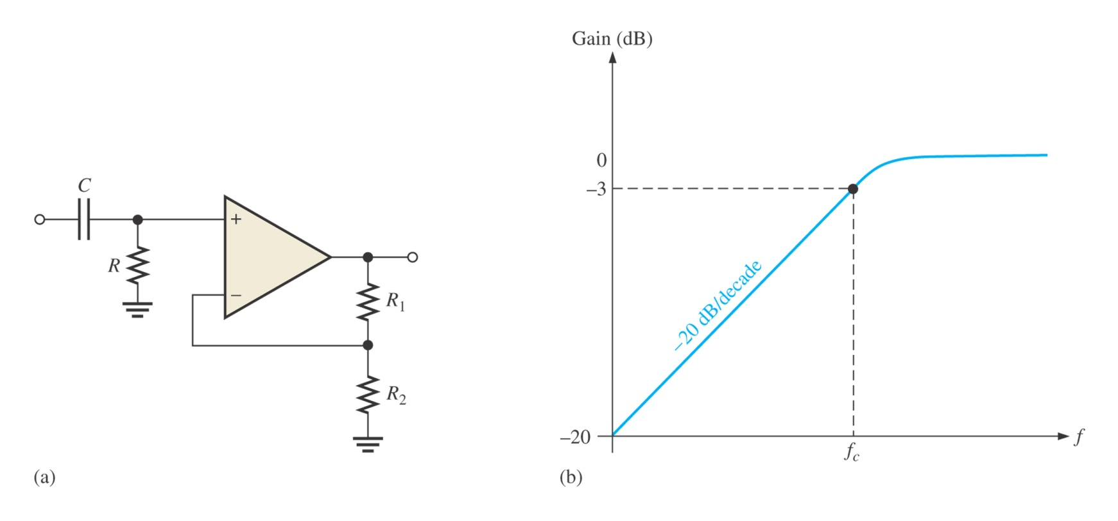
Single-Pole Filter
In high-pass filters, the roles of the capacitor and resistor are reversed in the RC circuits as shown from Figure (a). The negative feedback circuit is the same as for the low-pass filters.
Figure (b) shows a high-pass active filter with a -20dB/decade roll-off
Single-pole active high-pass filter and response curve.

Slide 39
The op-amp in single-pole filter is connected as a noninverting amplifier with the closed-loop voltage gain in the passband is set by the values of R₁ and R₂ :
The critical frequency of the single-pole filter is :

Slide 40
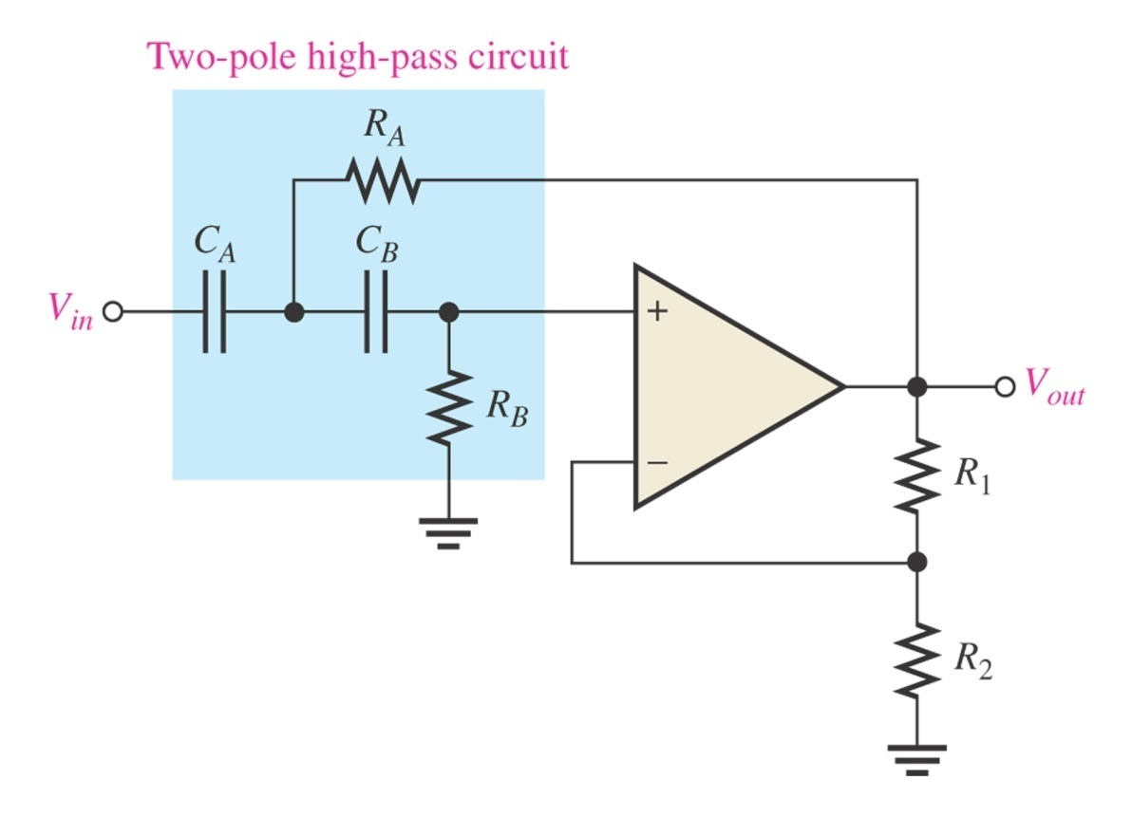
Sallen-Key High-Pass Filter
Components R_{A}, C_{A}, R_{B}, and C_{B} form the second order (two-pole) frequency-selective circuit.
The position of the resistors and capacitors in the frequency-selective circuit are opposite in low pass configuration.
There are two high-pass RC circuits that provide a roll-off of -40 dB/decade above fc
The response characteristics can be optimized by proper selection of the feedback resistors, R₁ and R₂.
Basic Sallen-Key high-pass filter.

Slide 41
The critical frequency for the Sallen-Key filter is :
For R_{A} = R_{B} = R and C_{A} = C_{B} = C, thus the critical frequency :

Slide 42
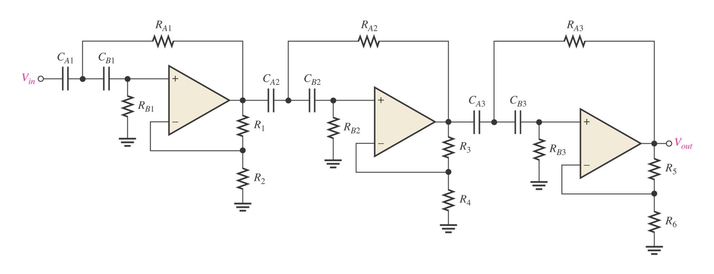
Cascading High-Pass Filter
As with the low-pass filter, first- and second-order high-pass filters can be cascaded to provide three or more poles and thereby create faster roll-off rates.
A six-pole high-pass filter consisting of three Sallen-Key two-pole stages with the roll-off rate of -120 dB/decade.
Sixth-order high-pass filter

Slide 43
ACTIVE BAND-PASS FILTERS
Cascaded Low-Pass and High-Pass Filters
Band-pass filter is formed by cascading a two-pole high-pass and two pole low-pass filter.
Each of the filters shown is Sallen-Key Butterworth configuration, so that the roll-off rate are -40dB/decade.

Slide 44
The lower frequency f_{c1} of the passband is the critical frequency of the high-pass filter.
The upper frequency f_{c2} of the passband is the critical frequency of the low-pass filter.

Slide 45
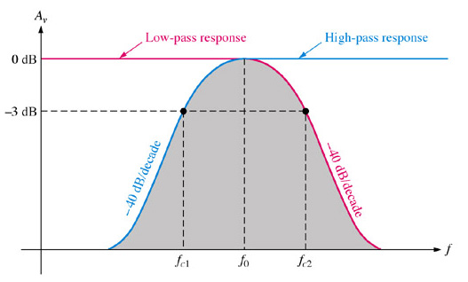
The following formulas express the three frequencies of the band-pass filter.
If equal-value components are used in implementing each filter,

Slide 46
Multiple-Feedback Band-Pass Filter
The low-pass circuit consists of
R₁ and C₁.
The high-pass circuit consists of
R₂ and C₂.
The feedback paths are through
C₁ and R₂.
Center frequency;

Slide 47
By making C1 = C2 =C, yields
The resistor values can be found by using following formula
The maximum gain, A_{o} occurs at the center frequency.

Slide 48
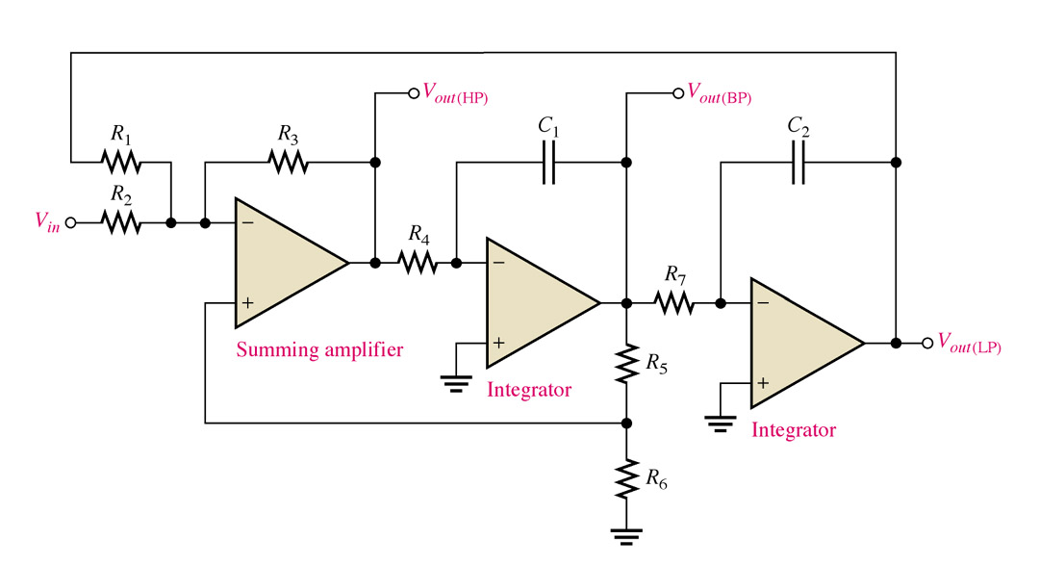
State-Variable Filter
State-Variable BPF is widely used for band-pass applications.

Slide 49
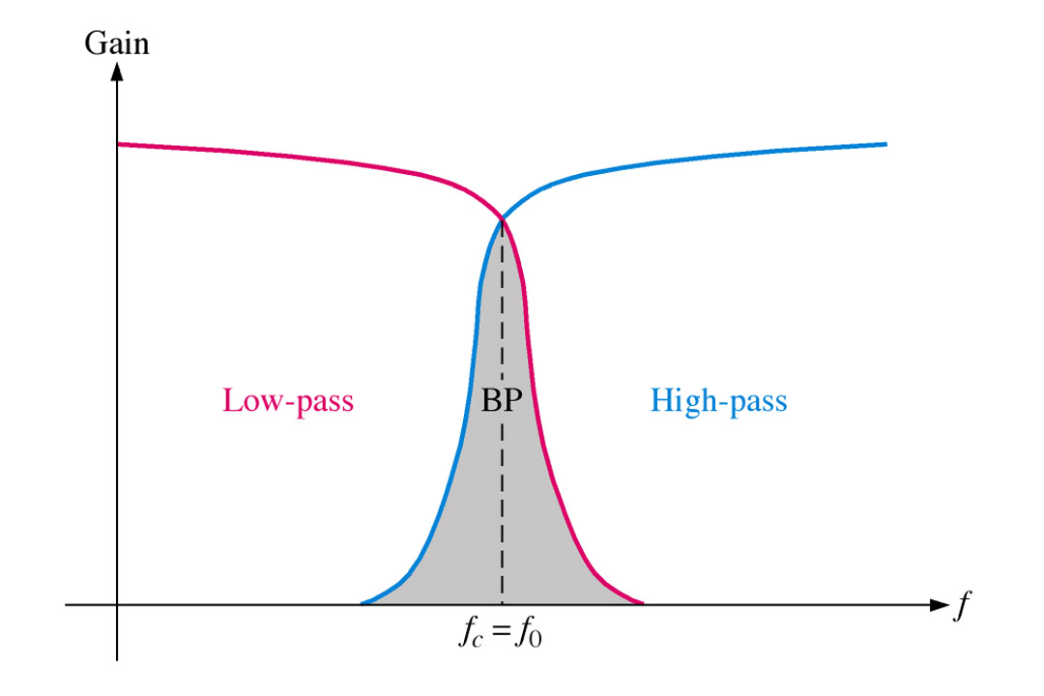
It consists of a summing amplifier and two integrators.
It has outputs for low-pass, high-pass, and band-pass.
The center frequency is set by the integrator RC circuits.
The critical frequency of the integrators usually made equal
R₅ and R₆ set the Q (bandwidth).
The band-pass output peaks sharply the center frequency giving it a high Q.

Slide 50
The Q is set by the feedback resistors R₅ and R₆ according to the following equations :

Slide 51
ACTIVE BAND-STOP FILTERS
Multiple-Feedback Band-Stop Filter
The configuration is similar to the band-pass version BUT R₃
has been moved and R₄ has been added.
The BSF is opposite of BPF in that it blocks a specific band of
frequencies

Slide 52
FILTER RESPONSE MEASUREMENT
Measuring frequency response can be performed with typical bench-type equipment.
It is a process of setting and measuring frequencies both outside and inside the known cutoff points in predetermined steps.
Use the output measurements to plot a graph.
More accurate measurements can be performed with sweep generators along with an oscilloscope, a spectrum analyzer, or a scalar analyzer.

Slide 53
SUMMARY
The bandwidth of a low-pass filter is the same as the upper critical frequency.
The bandwidth of a high-pass filter extends from the lower critical frequency up to the inherent limits of the circuit.
The band-pass passes frequencies between the lower critical frequency and the upper critical frequency.

Slide 54
A band-stop filter rejects frequencies within the upper critical frequency and upper critical frequency.
The Butterworth filter response is very flat and has a roll-off rate of –20 B
The Chebyshev filter response has ripples and overshoot in the passband but can have roll-off rates greater than –20 dB

Slide 55
The Bessel response exhibits a linear phase characteristic, and filters with the Bessel response are better for filtering pulse waveforms.
A filter pole consists of one RC circuit. Each pole doubles the roll-off rate. The Q of a filter indicates a band-pass filter’s selectivity. The higher the Q the narrower the bandwidth.
The damping factor determines the filter response characteristic.

