Slide 1

Senior Design
Restaurant Digital Ordering System
Division of Engineering Programs
by
Adesh Bhagirathy
Advisor: Dr. Baback Izadi

Slide 2
Organization
This presentation is organized by:
Overview & Background
Project Goals
Requirements – Functional & Non-Functional
Architecture
Design & Construction
Results & Conclusions

Slide 3
Overview & Background

Slide 4
Overview
My project is a system that allow restaurants to offer online ordering to their customers.
Restaurant
Customers
Website
Devices

Slide 5
Background
Why did it choose this project?
Issues addressed?
Current landscape and options
Place order in person
Phone
Website Information Only
Expensive Options

Slide 6
Project Goals

Slide 7
Project Goals
Build restaurant brand
Low cost
Fully managed
Promotes the restaurant and their brand
Lower cost but full featured options
Fully managed hosted options – lets restaurants do what they do best

Slide 8
Requirements

Slide 9
Functional design requirements
New channel – enhances the brand and ordering options
Presentation – Customer experience
  Simple but elegant
  Easy to use and navigate
  Intuitive and user friendly
Communication
  Get information and status
  Receipt and final confirmation
Ease of setup and configuration
Order processing

Slide 10
Non Functional requirements
Robust
  System is stable, reliable and not brittle
Scale
  System can scale with business growth and traffic
Extensible
  How easy to extend and add new features and functionality
Performance
  Load time / Interaction time
  Under load
Support
  How much support and maintenance is needed
Security
  How is it managed / How it safeguards user information

Slide 11
Architecture

Slide 12
Architecture
The system utilizes a multi-tier SOA architecture design.
Presentation Tier
Ordering
Order Processing
Services Tier
CRUD functions
Security / Access Control
Website
Mobile
Tablet
Create
Read
Update
Delete
Transaction data
Menu Data
Configuration Data
Data

Slide 13
Database Tier
MySQL Database
  Scalability and Flexibility
  High Performance
  High Availability
  Robust Transactional Support
  Strong Data Protection
  Comprehensive Application Development
  Low Total Cost of Ownership
Data Architecture & Model
  Data Relationship
  Table Structure
  Data configuration

Slide 14
Design & Construction

Slide 15
Data Model - Client
Client
Client Location
Address
Time zone
Client Location Hours
Days store is open
Store Delivers
Max Delivery Time
Times that store is open
Store Open flag
Client Location Service Area
Zip Codes the store services
Client Location Payment Types
Payment Types accepted by store
Payment type valid for delivery orders
Payment type valid for pickup orders

Slide 16
Data Model - Menu
Menu
Menu Item
Id
Item
Price
Description
Does the item have a size option
Does the item offer toppings
Does that item have various serving count options (Ex. 6 or 9 etc)
Menu Item Location
Location(s) that offer this menu item
Menu Item Toppings
Topping
Price
Notes
Menu Item Sizes
Size
Price
Notes
Menu Item Counts
Counts
Price
Notes
Menu Item Size Toppings
Different topping price by size

Slide 17
Data Model - Order
Order
Customer Order
Notification Type
Order Notification Preference
Payment Types
Supported Payment Types
Order Item
Items Ordered
Order Cd
Customer Id
Order Dates
Order Status
Order Type
Payment Type
Price
Quantity
Unit Price
Special Request
Customer
Name
Address
Contact Info
Preferences
Payment Type
Notification Type

Slide 18
Services Layer
Data Access Layer
  Create
  Read
  Update
  Delete
Business Logic Layer
  Calculation
  Manipulation
  Business Logic

Slide 19
Services Layer - SOA
  Windows Communication Foundation (WCF)
    A framework for building service-oriented applications. Data sent as asynchronous messages from one service endpoint to another.
  RESTful Web Service
    Representational State Transfer (REST) is an architectural style that specifies constraints, such as the uniform interface to improve performance and scalability.
  Returns JSON Objects
    JSON (JavaScript Object Notation) is a lightweight data-interchange format. It is easy for humans to read and write. It is easy for machines to parse and generate. It is based on a subset of the JavaScript Programming Language, Standard ECMA-262 3rd Edition - December 1999.

Slide 20
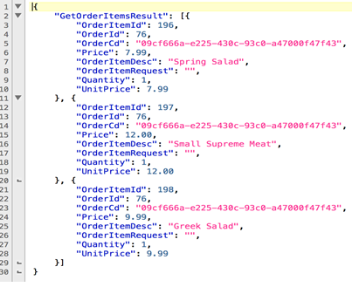
Services Layer - SOA
Returns JSON
JSON Example
GET (Reads)
  Get Orders – Client / Order Id
  Get Orders – Client / Order / Order Status
  Get Orders – Client / Search
PUT (Writes)
  Create Order – Order Info
  Update Order – Order Id / Order Status / Notes
  Update Order – Order Id / Order Item / Quantity / Price

Slide 21
Presentation Layer - Website
  Customer Website:
    Built on a reusable framework using using Microsoft’s ASP.NET MVC (Model View Controller)
      Model – Data stored / retrieved
      View – Output Presentation
      Controller – Processes interaction events and inputs
    Bootstrap
      Front-end framework
      HTML, CSS, Responsive Design
    jQuery
      A fast, small, and feature-rich JavaScript library
      HTML document manipulation, event handling, animation
      Built in AJAX support

Slide 22
Customer Interface
Web interface designed to allow the store to display their menu items in a clear and detailed way
Easy ordering options and shows information on the store location.
The system will check the customer location if the store restricts, expected, the ordering location.
Web application utilizes responsive design and will display correctly on most devices.

Slide 23
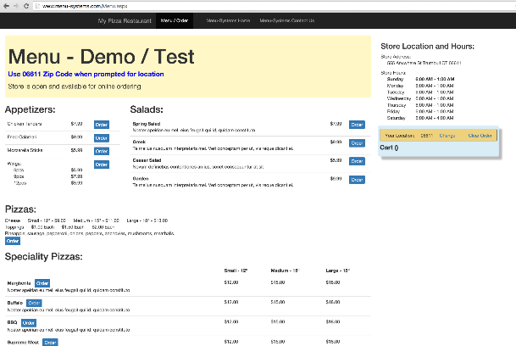
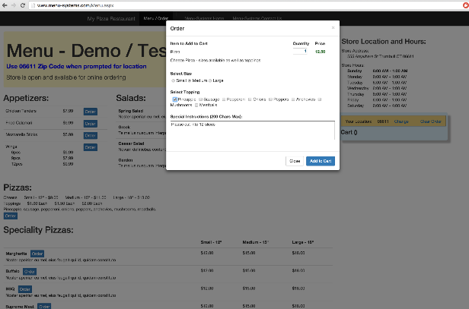
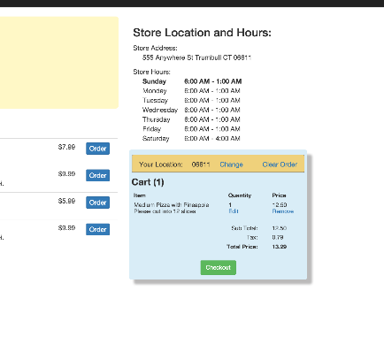
Design – Customer Experience
Website: Desktop / Laptop
Simple Design
Responsive
Get store info
Click on order Button
Order added to cart

Slide 24
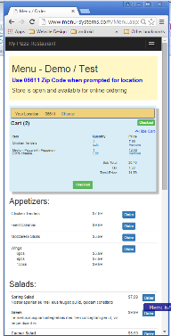
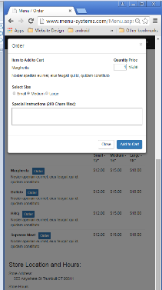
Design – Customer Experience
Website: Mobile / Tablet Smaller / Screen
Stacked Design

Slide 25
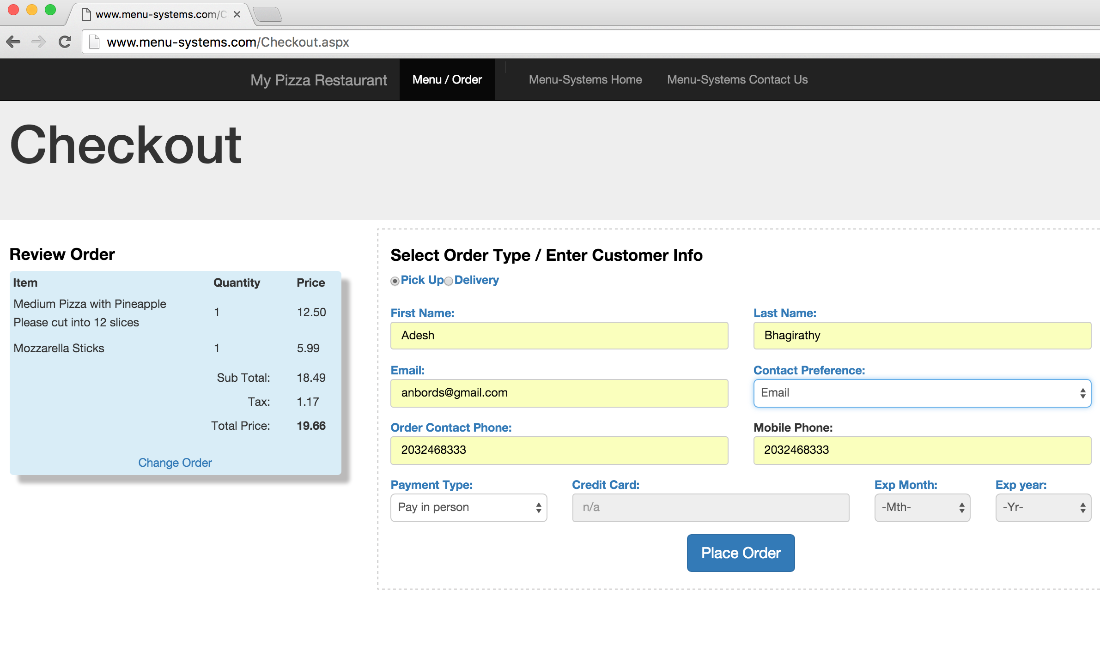
Design – Customer Experience
Website: Checkout
Simple Design
Order Summary
Responsive

Slide 26
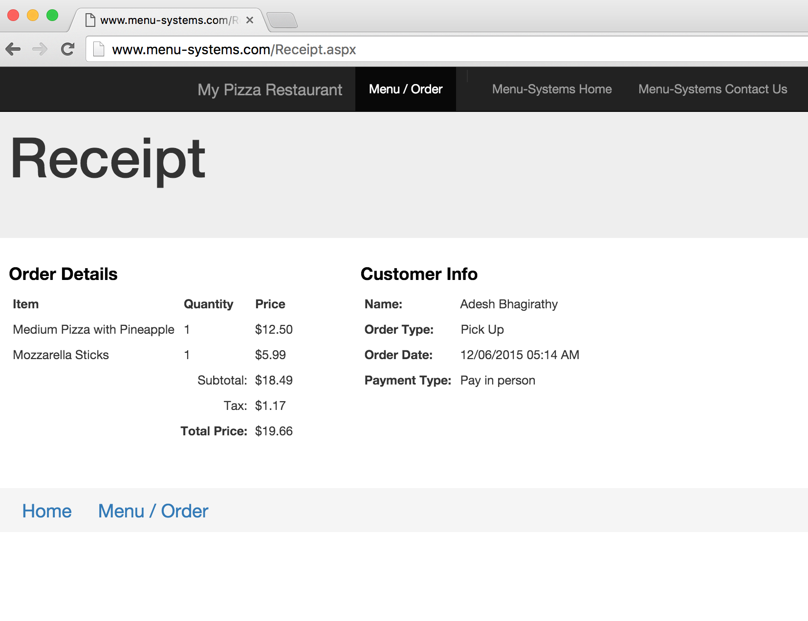
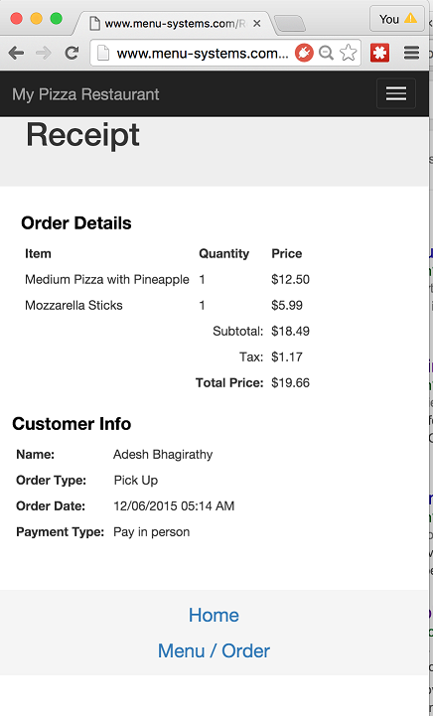
Design – Customer Experience
Website: Receipt
Simple Design
Order Summary
Responsive

Slide 27
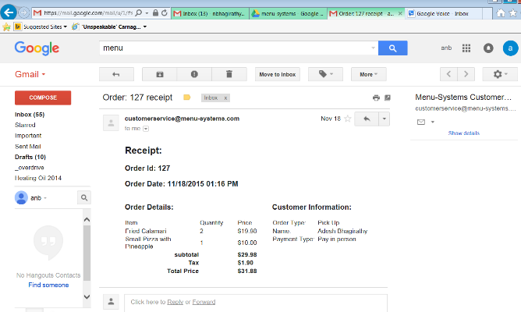
Design – Communication
Email Receipt

Slide 28
Presentation – Order Processing
Restaurant Order Processing
Custom Android Application
Rich application utilizing Android operating system
Take advantage of tablet features – touch, rich and robust user interface
Ease of development and low cost

Slide 29
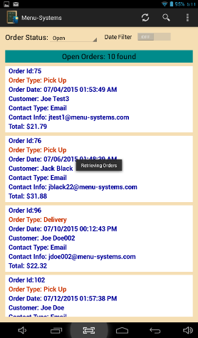
Android App
The restaurant or store receives and manages the orders via a native and proprietary Android App.
It makes use of the secure REST API’s (service layer) to retrieve and update data.
The application polls every few minutes to retrieve new orders.

Slide 30
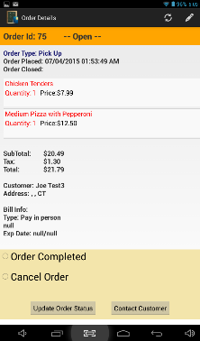
Android App
Order Details Module
Click on Order summary tile to drill into order details
Easily see detail information on order
List of order items
Shows price, tax and subtotals
Customer Information
Payment Information
Complete, Cancel the order
Contact customer

Slide 31
Android App – Order Details
Order Details Module
Click on Order summary tile to drill into order details
Easily see detail information on order
List of order items
Shows price, tax and subtotals
Customer Information
Payment Information
Complete, Cancel the order
Contact customer

Slide 32
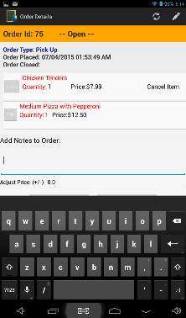
Android App – Edit Order Details
Edit Order Module
Edit Order
Update, Modify or Delete order items
  Price
  Quantity
  Notes to order
  Store Price Adjustment

Slide 33
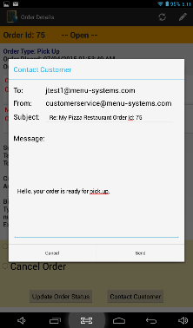
Android App – Communication
Communicate to Customer
Communication
Able to communicate with customer
Uses built in email functionality
Prefills customer information from order
Send updates / info on order

Slide 34
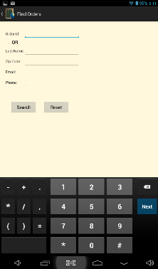
Android App - Search
Find Order(s)
Locate a particular order
Search by Order Id
Search by
  Name
  Email
  Phone
Search Module

Slide 35
Results & Conclusions

Slide 36
Engineering Constraints
Economic
There are several companies in this space the goal of this project was to deliver a full-featured system at a lower cost.
Environmental
The system is designed to be entirely digital and therefore paperless – reduced paper need and consumption which is beneficial to the environment.
Sustainability
Offers another business channel to restaurants. Potential for increased traffic and orders which help build the restaurant brand and has the economic benefit revenue to the local community if taxes and job creation.
Social & Political
The system is designed to promote and offer another channel of ordering for restaurants and small businesses. In use and function it has the socio-political ability to influence and change behavior to more self-service order placement.

Slide 37
Engineering Standards
This project and system is a software based digital ordering system which is reliant on the Internet, digital communications, transmission security and interface design standards.
World Wide Web Consortium
The World Wide Web Consortium (W3C) is an international community where Member organizations, a full-time staff, and the public work together to develop Web standards -Building and rendering web pages; web access from anywhere and any device; architecture and underlying technologies and principles for transmission and data structure
IETF
The Internet Engineering Task Force (IETF) is a large open international community of network designers, operators, vendors, and researchers concerned with the evolution of the Internet architecture and the smooth operation of the Internet. It is open to any interested individual. The IETF Mission Statement is documented in RFC 3935.
The actual technical work of the IETF is done in its working groups, which are organized by topic into several areas (e.g., routing, transport, security, etc.).
ISOC
The Internet Society (ISOC) is a global cause-driven organization governed by a diverse Board of Trustees that is dedicated to ensuring that the Internet stays open, transparent and defined by you.
They are a trusted independent source of leadership for Internet policy, technology standards, and future development. More than simply advancing technology, they work to ensure the Internet continues to grow and evolve as a platform for innovation, economic development, and social progress for people around the world.

Slide 38
Future Improvements
Security
Improve Service Layer security.
IP Filtering
Admin Portal
The DB configuration is all done via scripts at this point. This is fine for now, but a future improvement would be to create a portal to manage the DB configuration.
Communication Preference
The current system, while it supports SMS, only has email communication setup and working. Taking advantage of SMS and having the ability to communicate with a customer via SMS is a natural extension of the system in offering a fully digital experience.
Store Interface (tablet application)
Real-world experience and usage feedback

Slide 39
Conclusion
Goal was to design a reusable, scalable and extensible Restaurant Digital Ordering System
  Achieved?
    Yes – I believe that I was able to develop a commercially viable system.
    System meets the functional and non-functional requirement.
    System is robust and scalable.
    Sound and proven architecture and technologies utilized.
    Simple, Intuitive and user friendly customer design
    Robust and responsive order processing tablet application.

